Slide 1
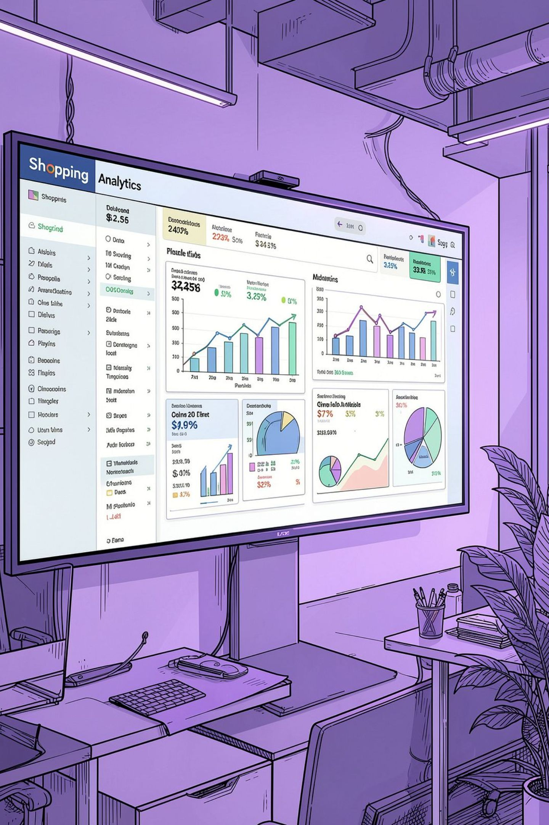
Shopping Trends And Customer Behaviour
Analysis of 3,900 transactions to reveal spending trends, customer segments, product preferences and membership patterns to inform strategic decisions.

Slide 2
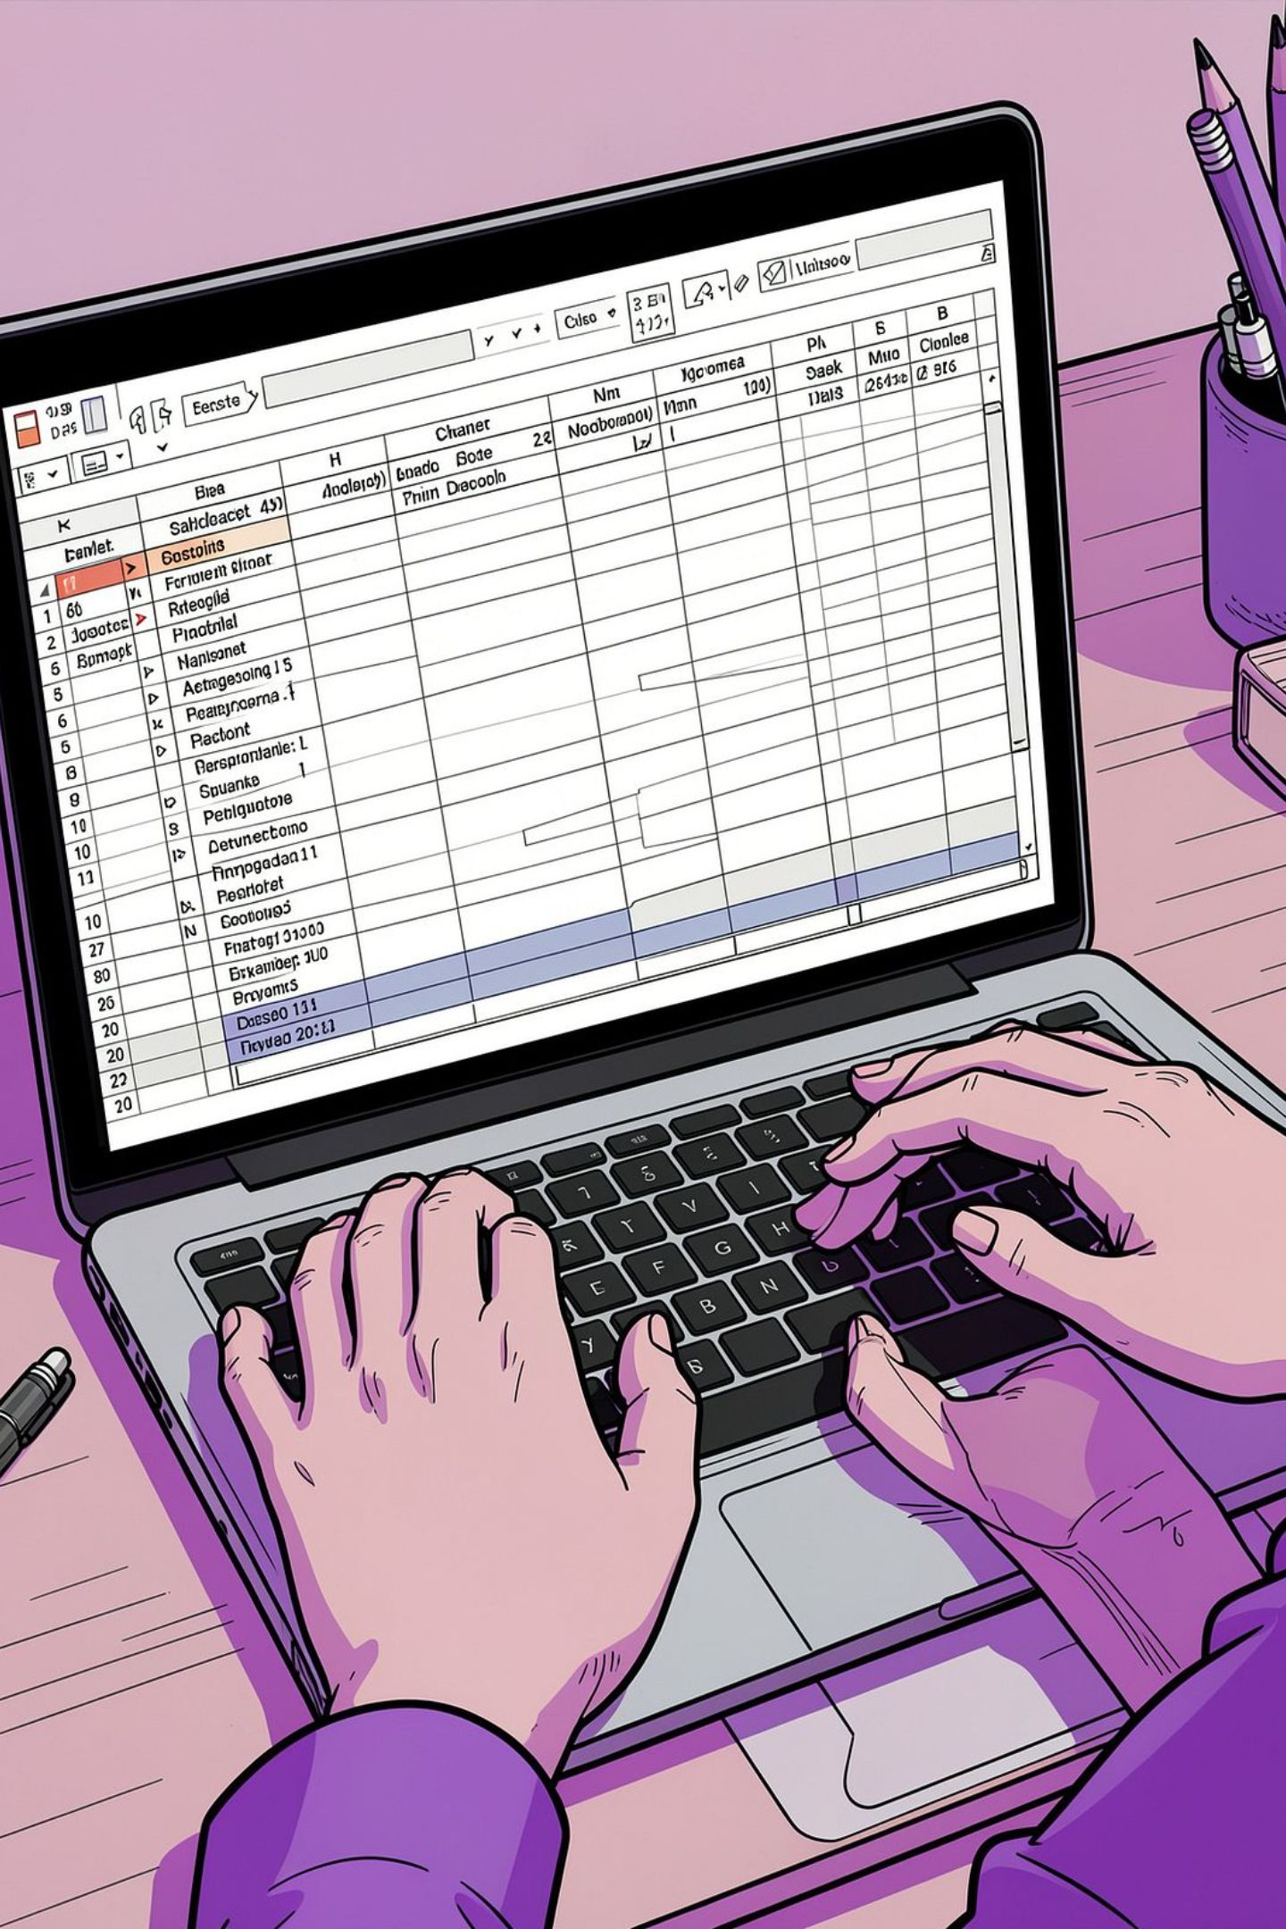
Dataset Overview
Rows & Columns
Key Features
Summary Stats
Age, gender, location, subscription status, item, category, amount, season, size, colour, review rating, shipping, discounts, previous purchases, frequency, payment method.
3,900 rows × 18 columns covering demographics, purchase details and behaviour.
• Mean purchase: $59.76
• Avg age: 44.07
• Avg rating: 3.75
• Frequency mean: 89 days

Slide 3

Data Preparation (Python)
Standard workflow:
import with pandas,
inspect with df.info() and describe(),
standardise column names to snake_case,
derive age_group and purchase_frequency_days,
check consistency between discount_applied and promo_code_used and remove promo_code_used,
export CSV and load to SQL Server.

Slide 4
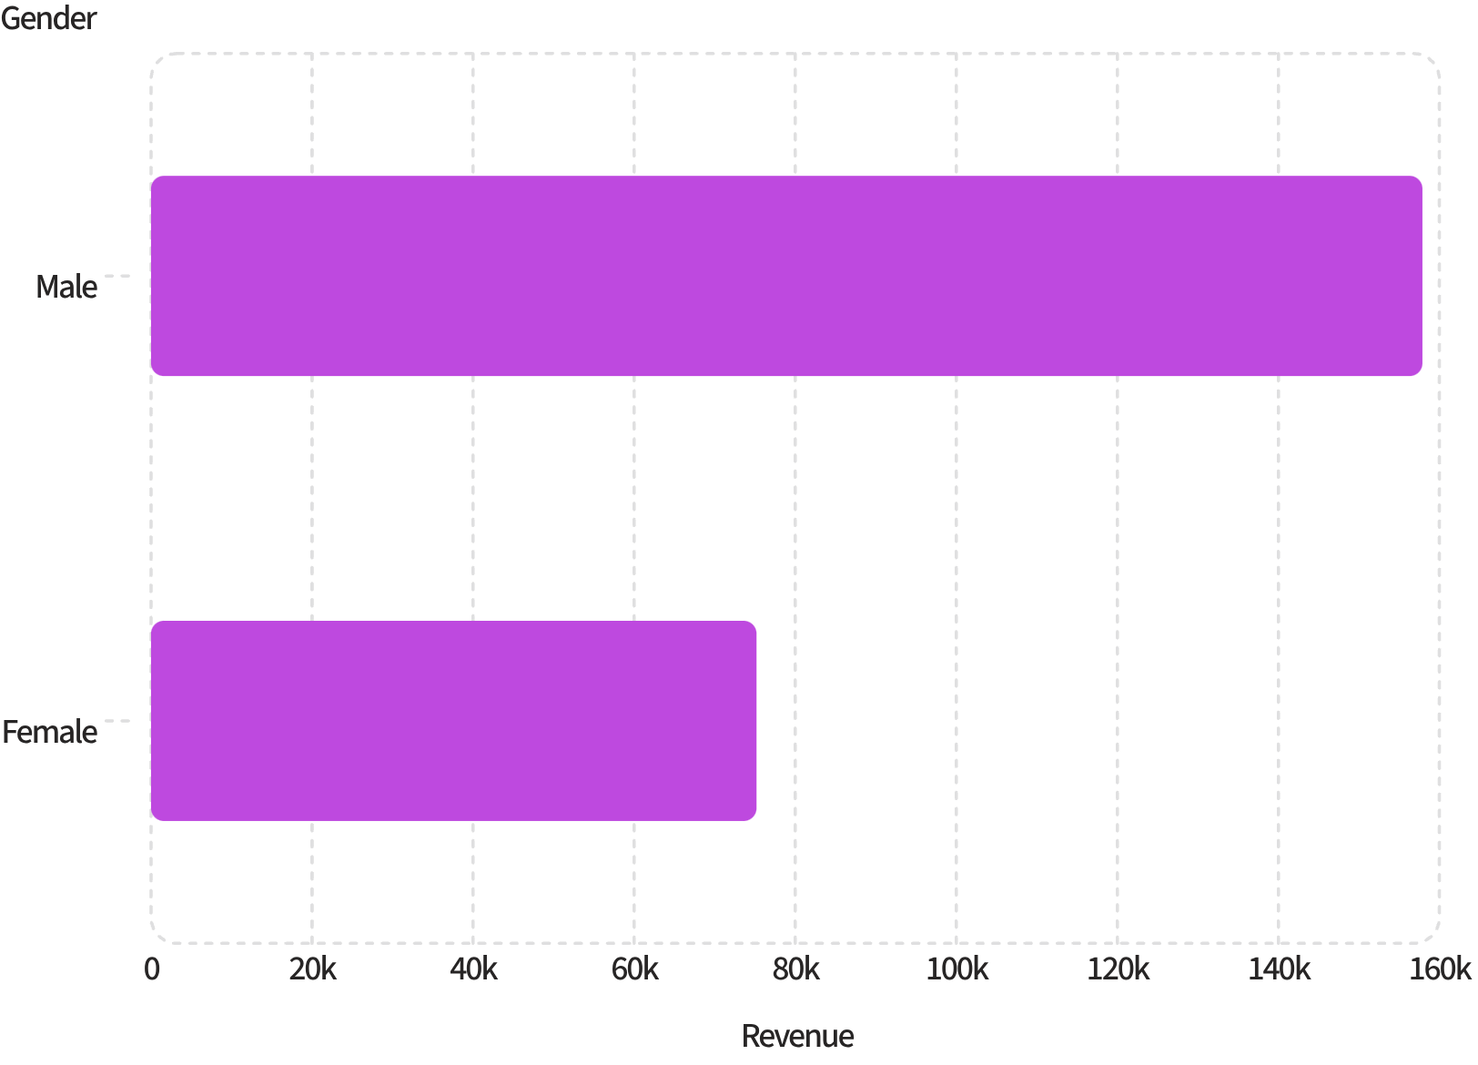
Revenue by Gender
Insight
Male customers generated substantially more revenue ($157,890) than female customers ($75,191). Consider targeted offers and product mixes by gender.

Slide 5
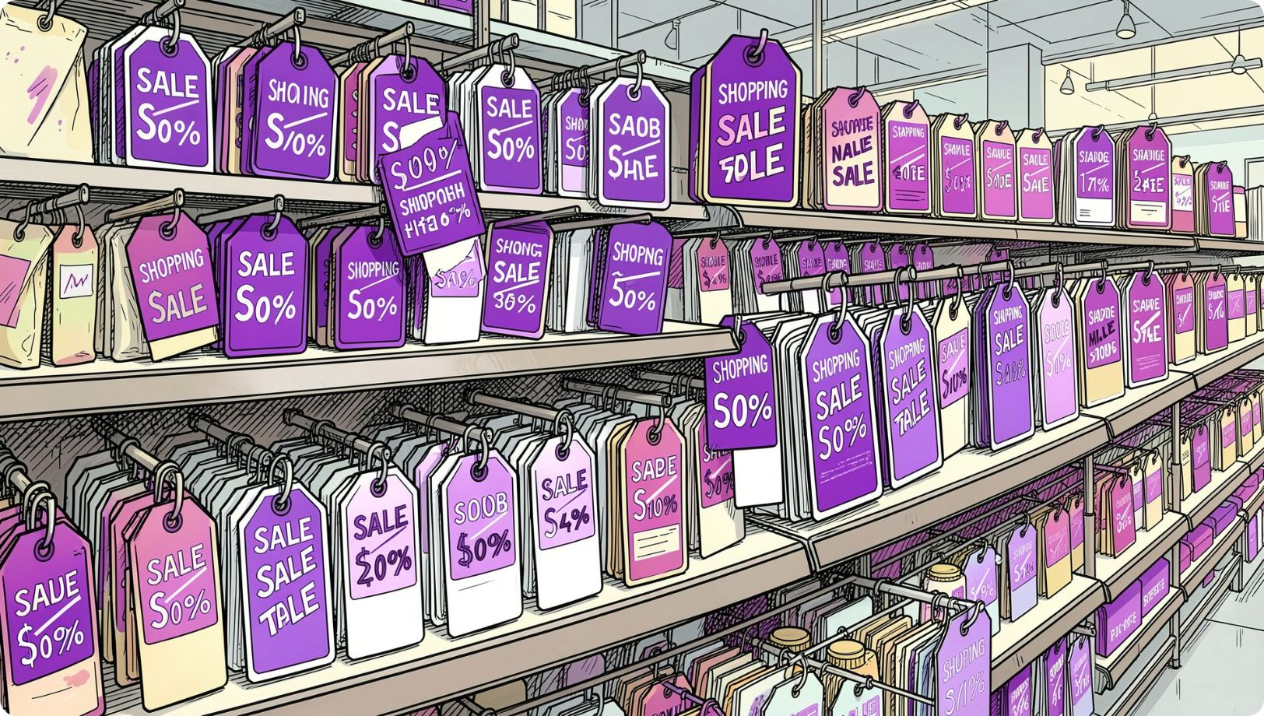
Discount Behaviour & High Spenders
Top discounted spenders (examples)
Multiple customers used discounts yet spent ≥ top order value (sample top IDs with purchase_amount=100). Review discount policy: high spend persists despite promotions.
Customer IDs: 43, 96, 194, 205, 244, 249, 456, 519, 582, 616 (purchase_amount 100)

Slide 6

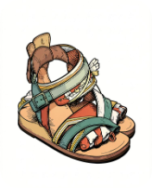
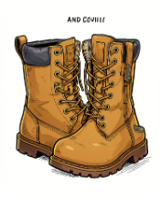
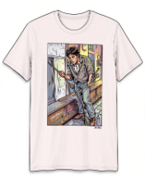

Top-Rated & Discount-Dependent Products
Gloves
Sandals
Boots
Avg rating 3.86 • Discount rate 50%
Avg rating 3.84 • Discount rate high (49.66%)
Avg rating 3.81 • Discount-dependent (49.07%)
T-shirt
Hat
Avg rating 3.78 • Discounted frequently
Avg rating 3.81 • Highest discount share (50%)

Slide 7
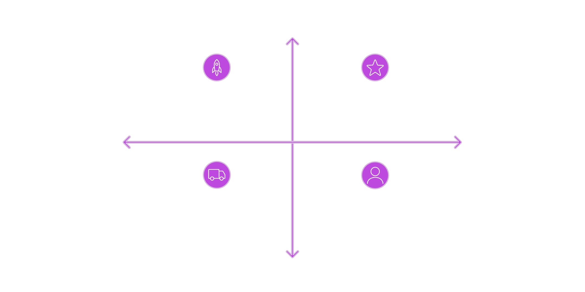
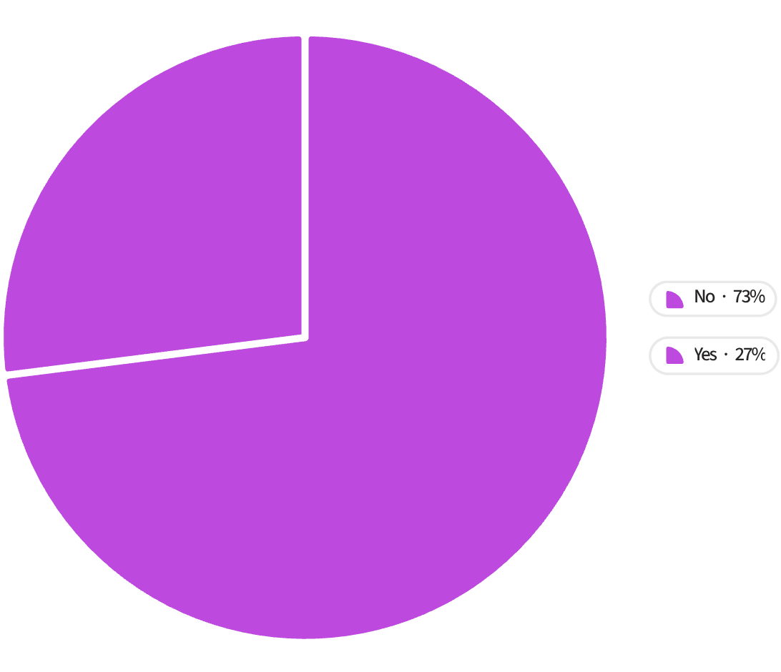
Shipping & Membership Comparisons
Higher Avg Purchase
Express: Higher Avg $60
Express: Popular, Prioritise UX
Less Preferred
More Preferred
Standard: Avg $58, Broad Base
Standard: Lower Priority vs Express
Lower Avg Purchase
Subscription: 27% Yes, 73% No. Avg spend similar (~$59) though total revenue higher for non-subscribers due to larger base.
Express slightly higher average purchase ($60) vs Standard ($58). Prioritise Express experience.

Slide 8
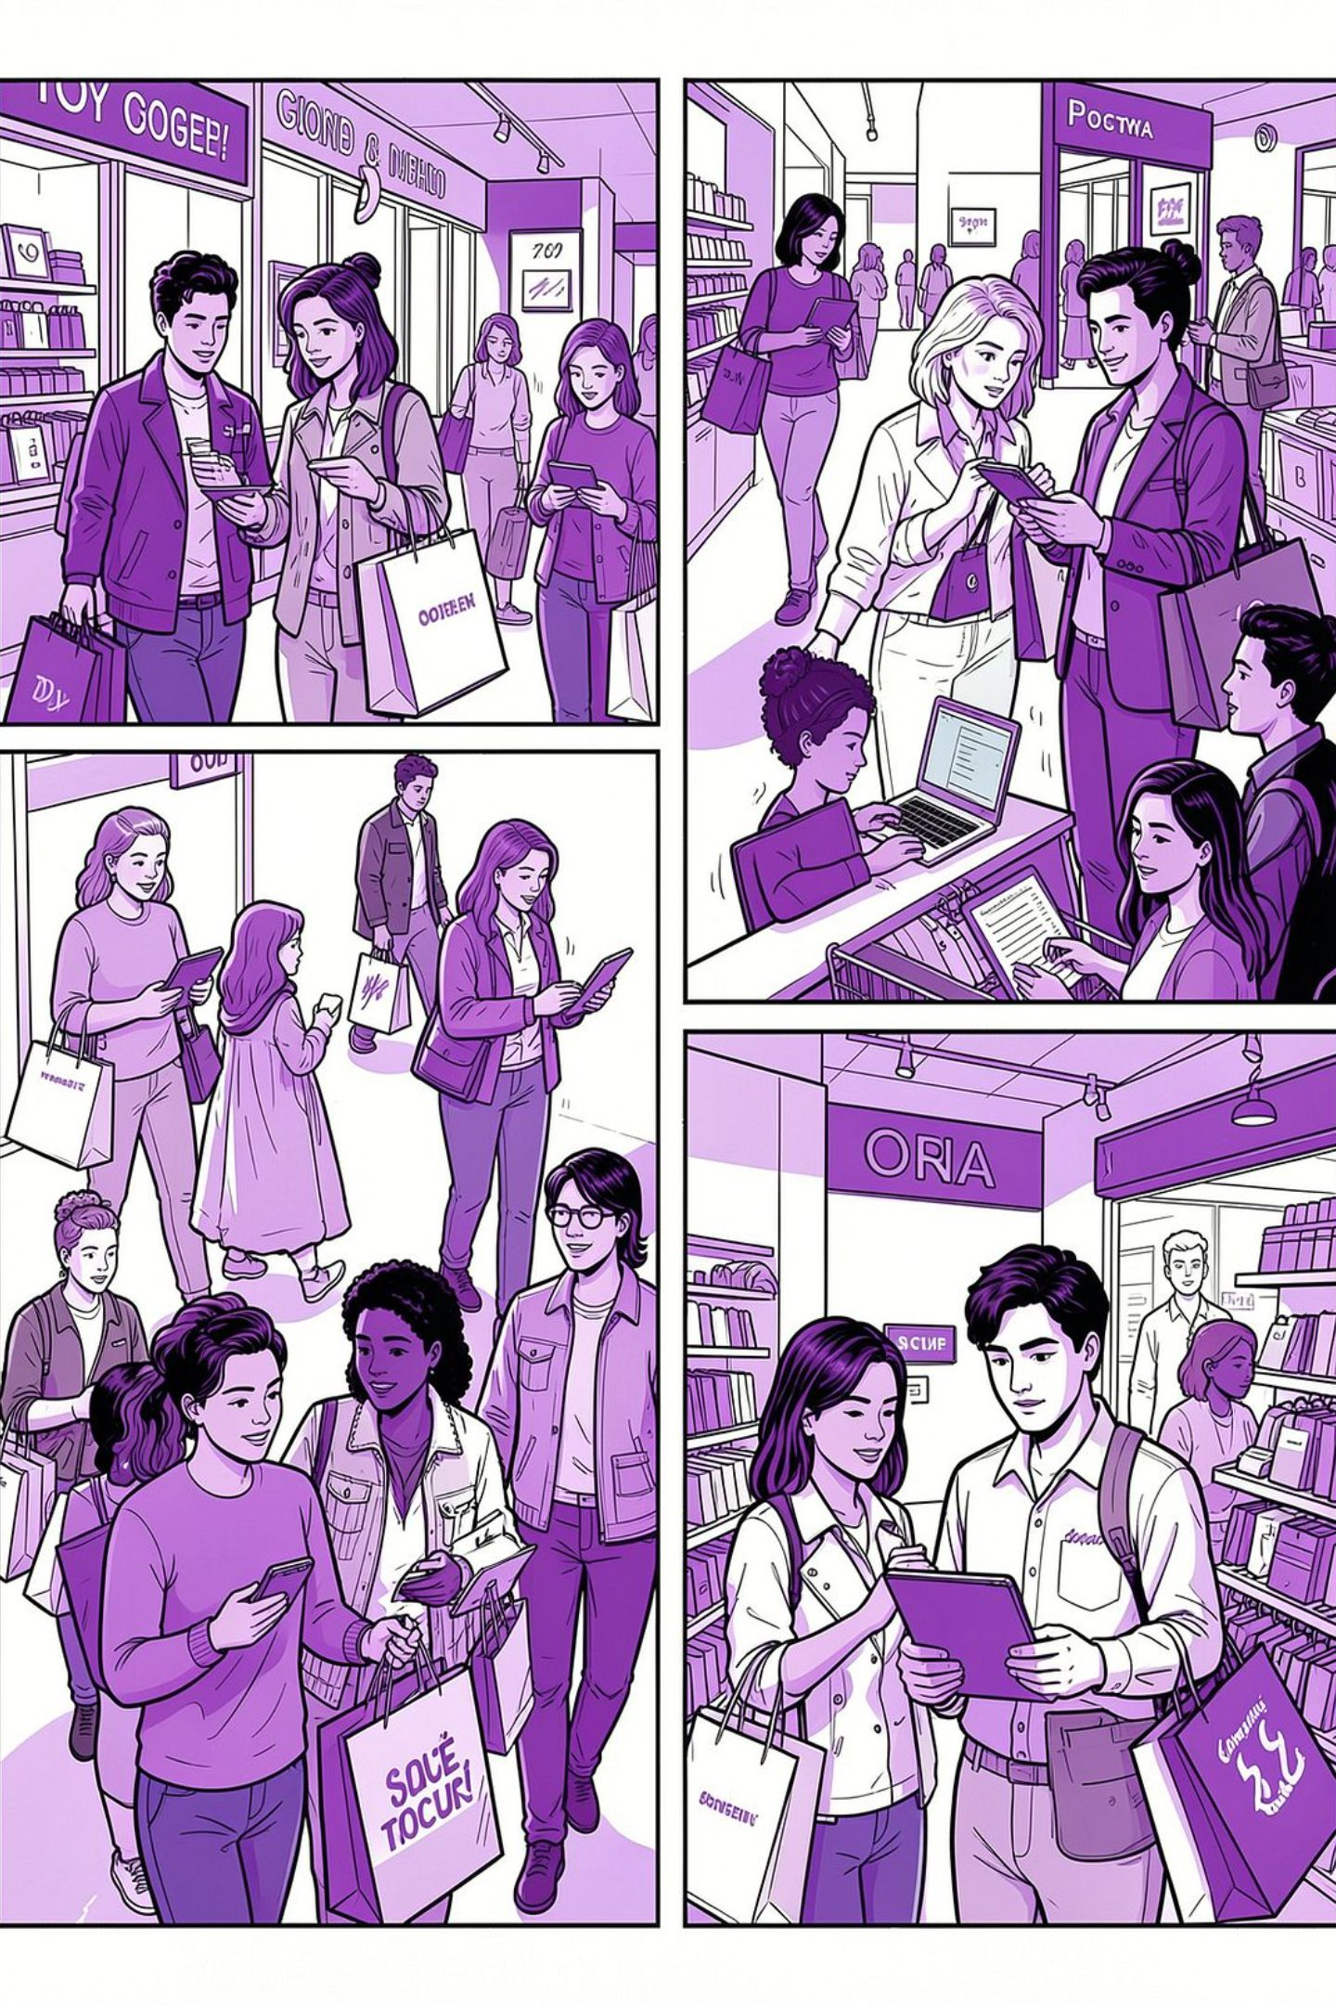

Customer Segments & Loyalty
1
2
3
Returning
Loyal
New
701 customers — repeat purchasers.
3,116 customers — majority of base and revenue.
83 customers — growth opportunity.
2,500+ customers made >5 purchases but remain unsubscribed — target for membership push.

Slide 9
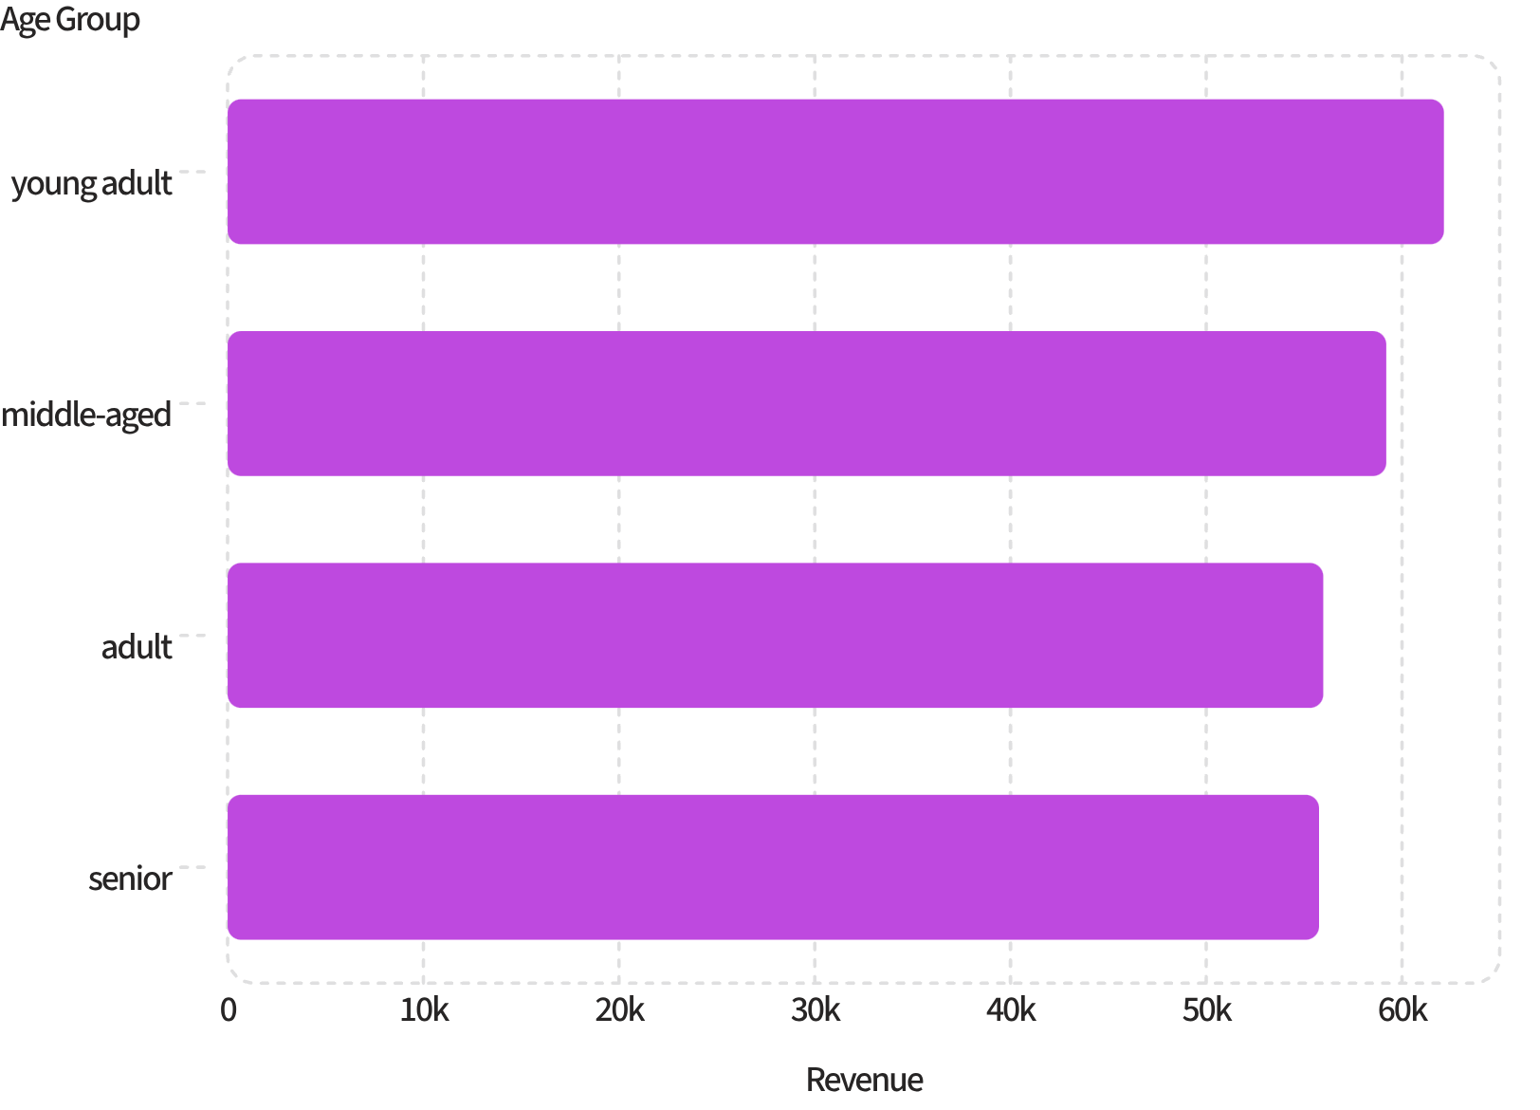
Top Products & Age Group Revenue
Top items by category (examples)
Accessories: Jewelry (171), Sunglasses (161), Belt (161).
Clothing: Blouse (171), Pants (171), Shirt (169).
Footwear: Sandals (160), Shoes (150), Sneakers (145).
Outerwear: Jacket (163), Coat (161).

Slide 10
Recommendations
Membership & Loyalty
Upgrade membership benefits and target 2,500+ frequent buyers who haven’t subscribed.
Targeted Marketing
Invest in youth-focused campaigns and tailor creatives by gender to boost high-revenue segments.
Express Shipping
Prioritise and expand Express options to capture slightly higher spenders.
Product & Pricing
Promote top-rated bestsellers and consider premium pricing where demand and ratings support it.
Discount Policy
Review discount dependence on certain products to protect margins and product perception.

